Slide 1
Geo-fenced Smart Attendance App
Terna Engineering College, Nerul
Computer Engineering Department
By
Yash Avinash Vishe TU3F1920088
Mihir Rajendra Bachhav TU3F1920086
Nishant Ashok Patil TU3F1920095
Omkar Prakash Mande TU3F1920075
Under the Guidance of :
Prof. Pravin Hole

Slide 2
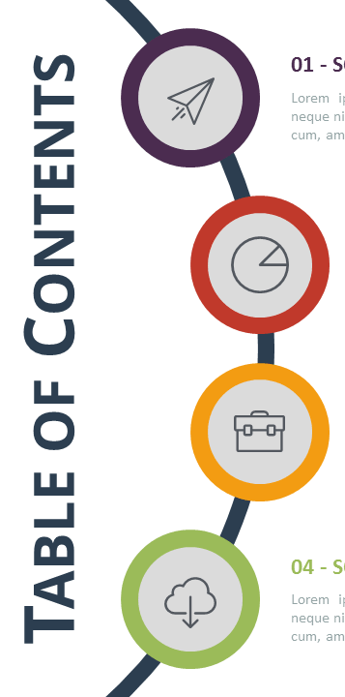


Introduction
Abstract
Literature Survey
Problem Statement
Proposed Methodology
DFD level 0 and Timeline chart
Use Case Diagram
Class Diagram
Technology Stack

Slide 3

Introduction
Attendance tracking is a time consuming process determining the performance of the organization/institution.
Managing attendance using the traditional methods becomes tedious when we consider a large population.
There is a dire need for an efficient system that can solve problems.
Therefore, automated attendance system becomes necessary to organizations most especially in the educational sector.
An automated attendance system which works using a GPS tracking system would provide the needed solution in almost all educational organizations.

Slide 4

ABSTRACT
Smartphones have become increasingly popular among teenagers and are always with them.
Attendance tracking can be upgraded using new technologies like geo-fencing that use smartphones.
System aims to capture attendance smartly by determining students location.
Geofencing is a location-based service that allows a particular entity to perform actions based on smartphone users location when they enter a
predetermined location, known
as geo fence.

Slide 5

Problem Statement
Keeping track of attendance in any educational organization has been challenging for many reasons. For decades, colleges and schools have been using traditional methods which are incomplete and/or inefficient in their core. The proposed application aims at transforming current attendance tracking systems by involving and combining latest standard technologies and advancements in geo-fencing.

Slide 6
Literature Survey
Sr. No. | Title | Author, Date Published | Problem Addressed | Advantages | Disadvantages
1. | Location Based Attendance Monitoring System | Aayushi Singh, Tanya Goel, Astha Singh -May 2020 | Monitoring attendance for all students using teachers mobile phones. | The records are stored in the database and scope for biometric authentication. | Real time live tracking for students not included.
2. | Geofencing Based Attendance Monitoring System | A.O, Dosumu -January 2021 | Implements model for monitoring attendance of students in large classes using geofencing. | Highly accurate location co-ordinates (up to 10 decimal points) | No tracker system for individuals.
3. | Smart Geofencing: An Inventive Mobile Marketing Strategy | Aagy Paulose, Nurjahan V A -06 June-2019 | Marketing based Service with geofencing and in creating smarter geofences. | Shows potential scope for geofencing. | Focused on marketers for recommending places and not on collecting data.

Slide 7

Proposed Methodology
Creating a virtual geo fence boundary of the campus/workplace using longitude/latitude data and marking it on maps
Creating a user app which streams user location to server once app is turned on. Server checks if the location co-ordinates lie within the geo-fence
If the user's longitude and latitude falls under the range of specified classroom/workplace then the attendance is considered to be valid.
Creating a Admin side application which allows admin to view active users within the boundary, name, age, timestamp, last seen location of the user inside the campus, check-in/checkout time of the user,
Further user side app can be improvised to add schedule updates, attendance notifications etc.
The admin can generate attendance which are stored in the database in graphical ways which helps in proper analytics.

Slide 8
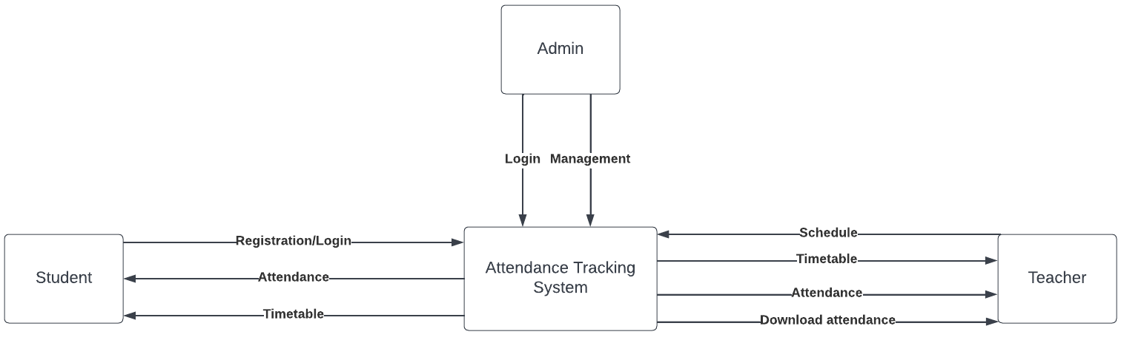
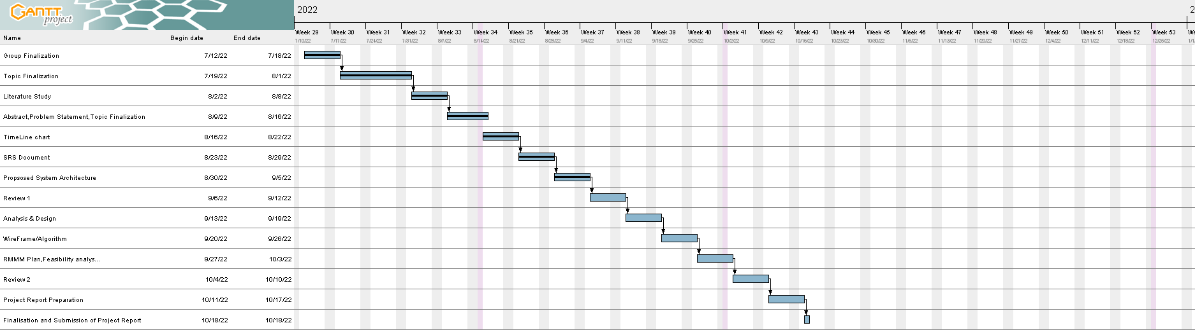
DFD level 0
Timeline Chart

Slide 9
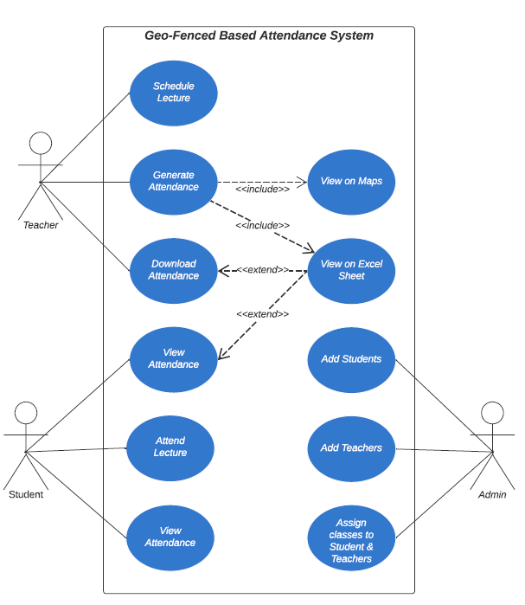

Use Case Diagram

Slide 10
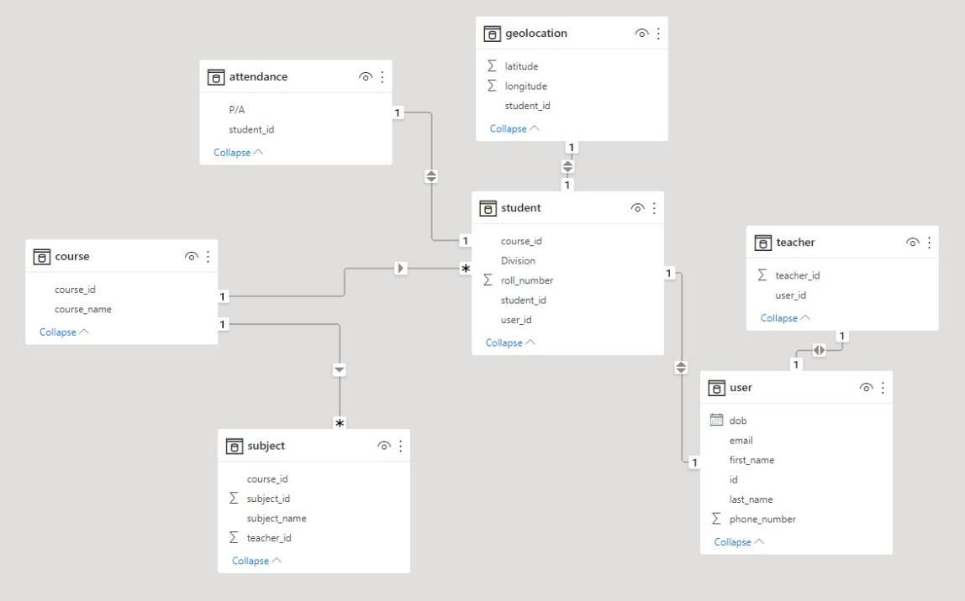
Class Diagram

Slide 11




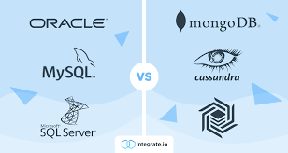
Technology Stack
MOBILE APPLICATION:FLUTTER FRAMEWORK AND DART
BACKEND SERVER:NODE.JS
THIRD-PARTY API:GOOGLE MAPS(LOCATION SERVICE)
DATABASE:SQL/NOSQL(DEPENDS ON USECASE)
Non Functional Requirements
ANDROID DEVICE USING ANDROID 9.0 AND ABOVE WITH AT LEAST 2 GB RAM AND 2 GB STORAGE
INTERNET CONNECTIVITY WITH LOCATION ACCESS TO THE APPLICATION

